Slide 1

  .
ECE Department Course Registration System
Term Project - EE202: Object-Oriented Computer Programming
Team Members:
Abdulelah
Suliman
Saeed
Baraa
Muhtadi
Alaa

Slide 2
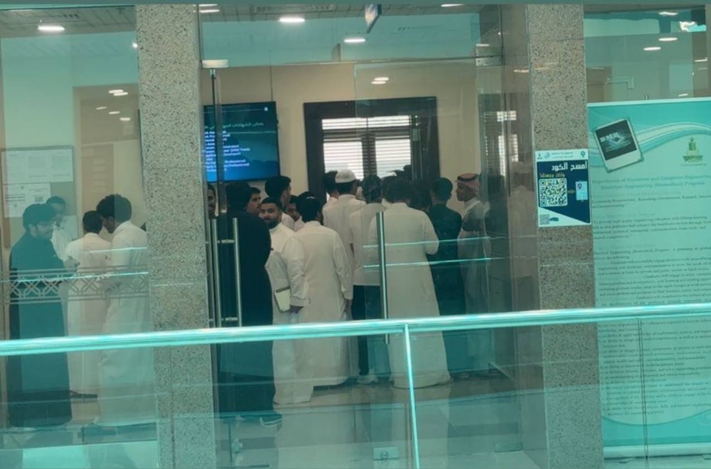
  Project Overview
"Students crowded due to registration problems."
The Problem: The need for an automated system to manage complex academic rules and prevent scheduling conflicts.
The Solution: A software solution designed to streamline the course registration process for the ECE department.
Goal: Facilitate an efficient, error-free registration experience.

Slide 3
Technical Stack and Tools
The system shall adhere to the following technical standards:
Programming Language: Python 3.x (latest stable release).
GUI Framework: PyQt5 for a responsive and user-friendly interface.
Database: SQLite3 for persistent data storage.
Design Paradigm: Object-Oriented Programming (OOP) with modular, reusable classes.

Slide 4
  System Functionality
For Students:
Smart Registration: Automatically validates prerequisites and checks for time conflicts.
Visual Timetable: Displays a clear, color-coded weekly schedule.
Credit Logic: Enforces minimum and maximum credit hour limits.
For Administrators:
Course Management: Add, delete, and modify courses with specific schedules.
Plan Management: Define curriculum plans for Computer, Power, and Comm programs.

Slide 5
  Challenges and Solutions
Challenge 1: Complex Prerequisites
Solution: Implemented a recursive check that verifies a student's transcript before allowing registration.
Challenge 2: Program Plan Validation
Solution: Created a specific "Manage Plans" module to link courses to specific program levels, ensuring students follow their track.

Slide 6
System Demonstration

Slide 7
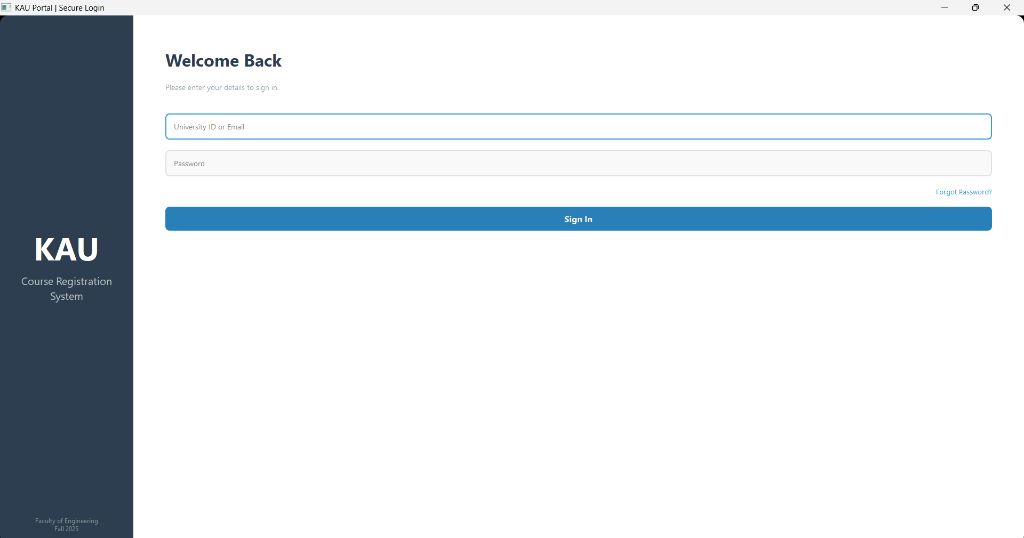
Login Screen
Includes Password
Recovery

Slide 8
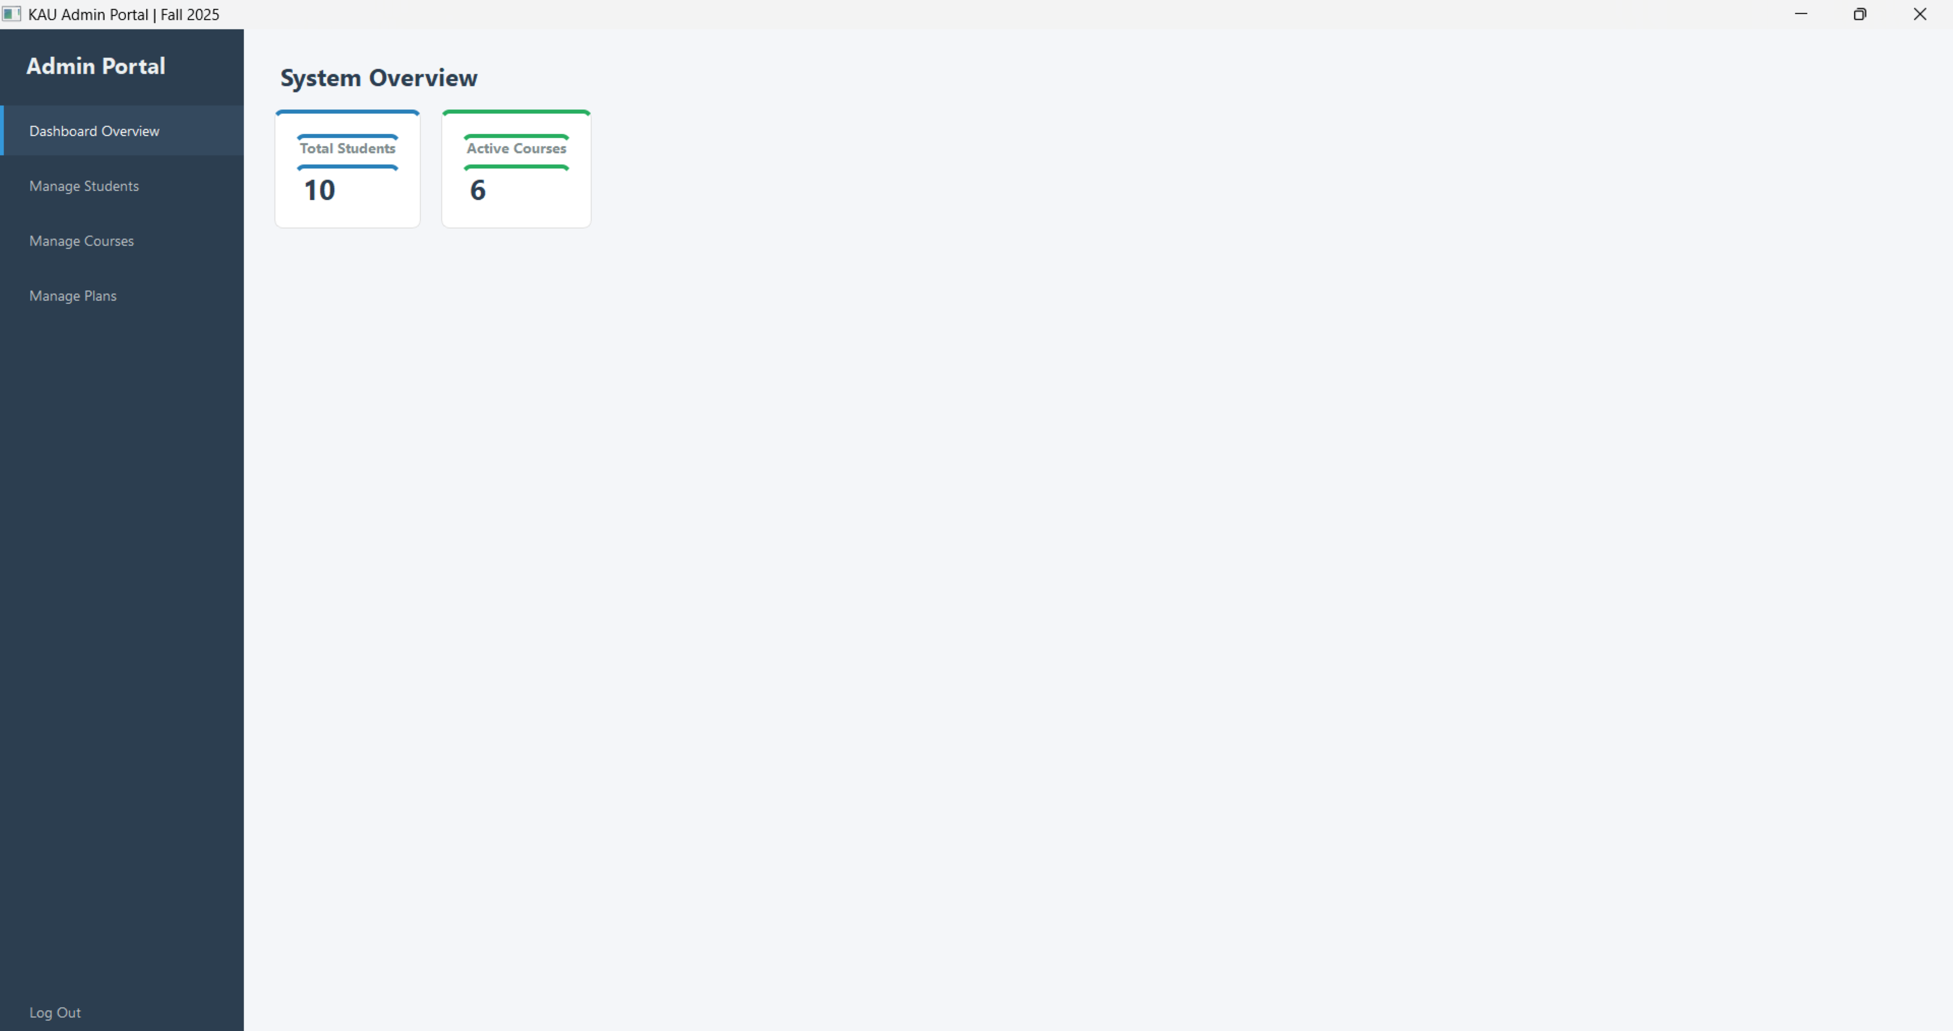
  Admin main dashboard

Slide 9
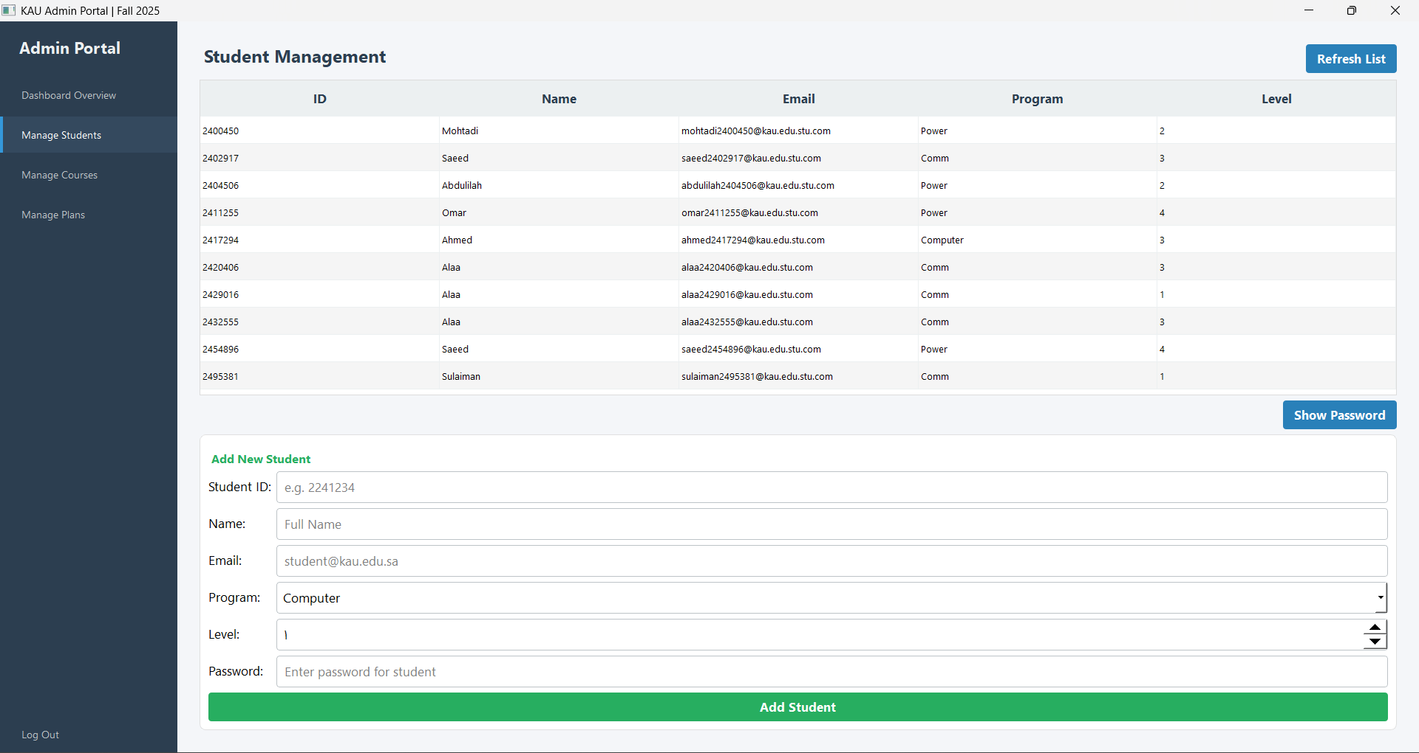
  (Admin)
  Manage student

Slide 10
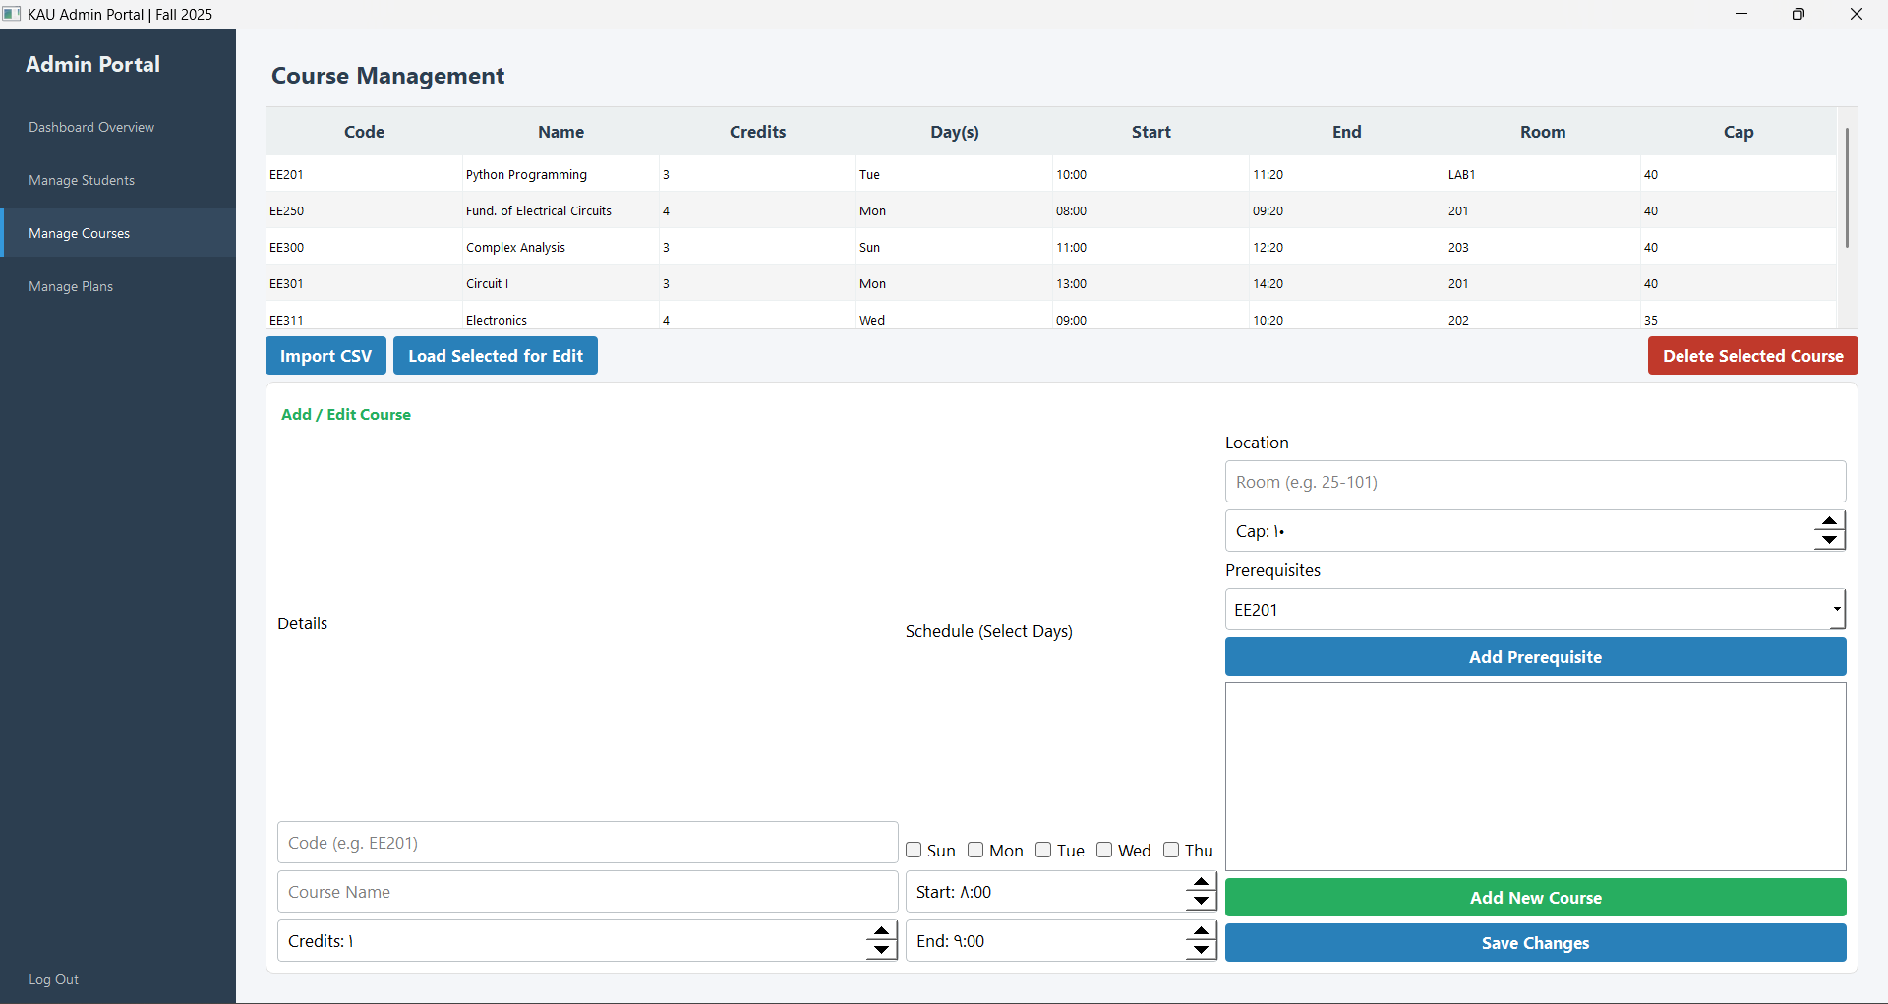
  (Admin)
  Manage Courses

Slide 11
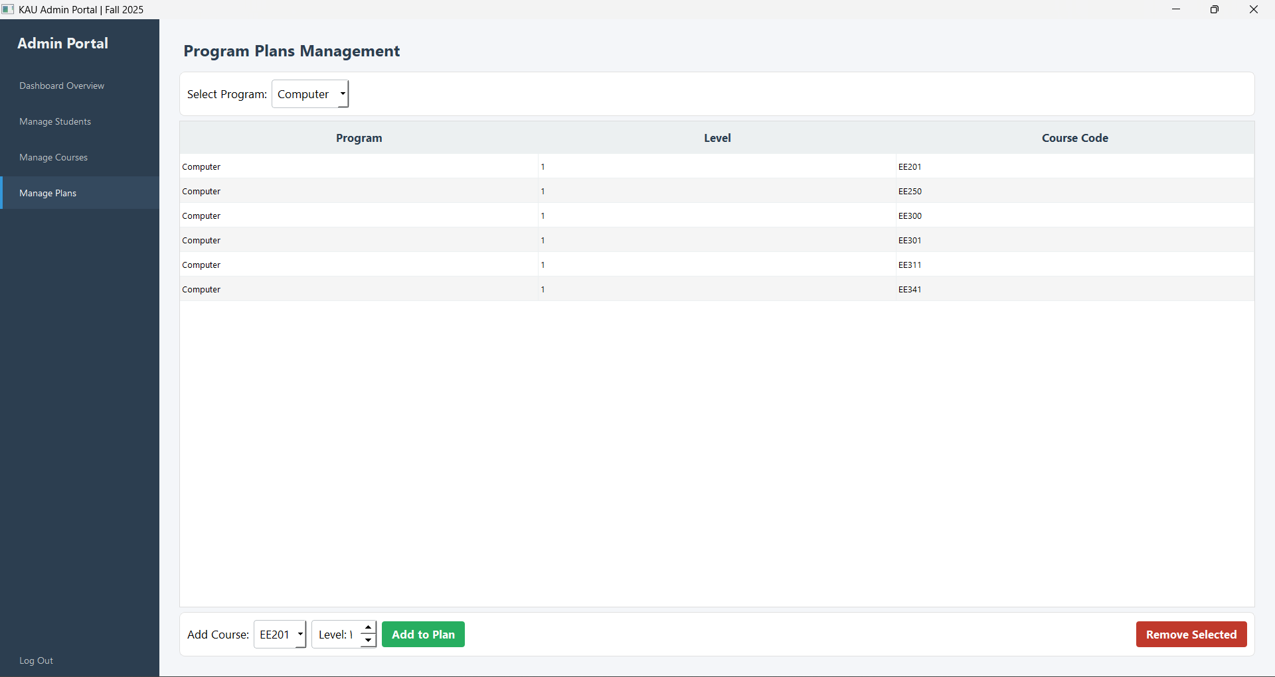
  (Admin)
  Manage Plans

Slide 12
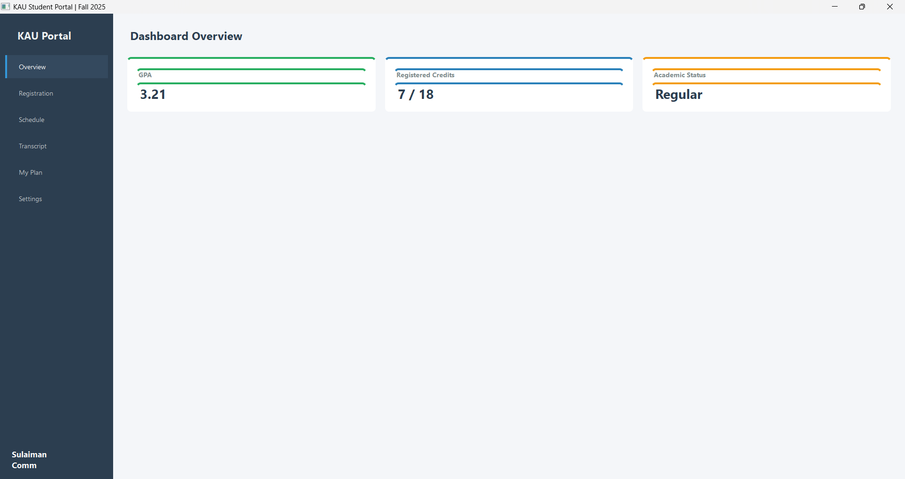
  Student main dashboard

Slide 13
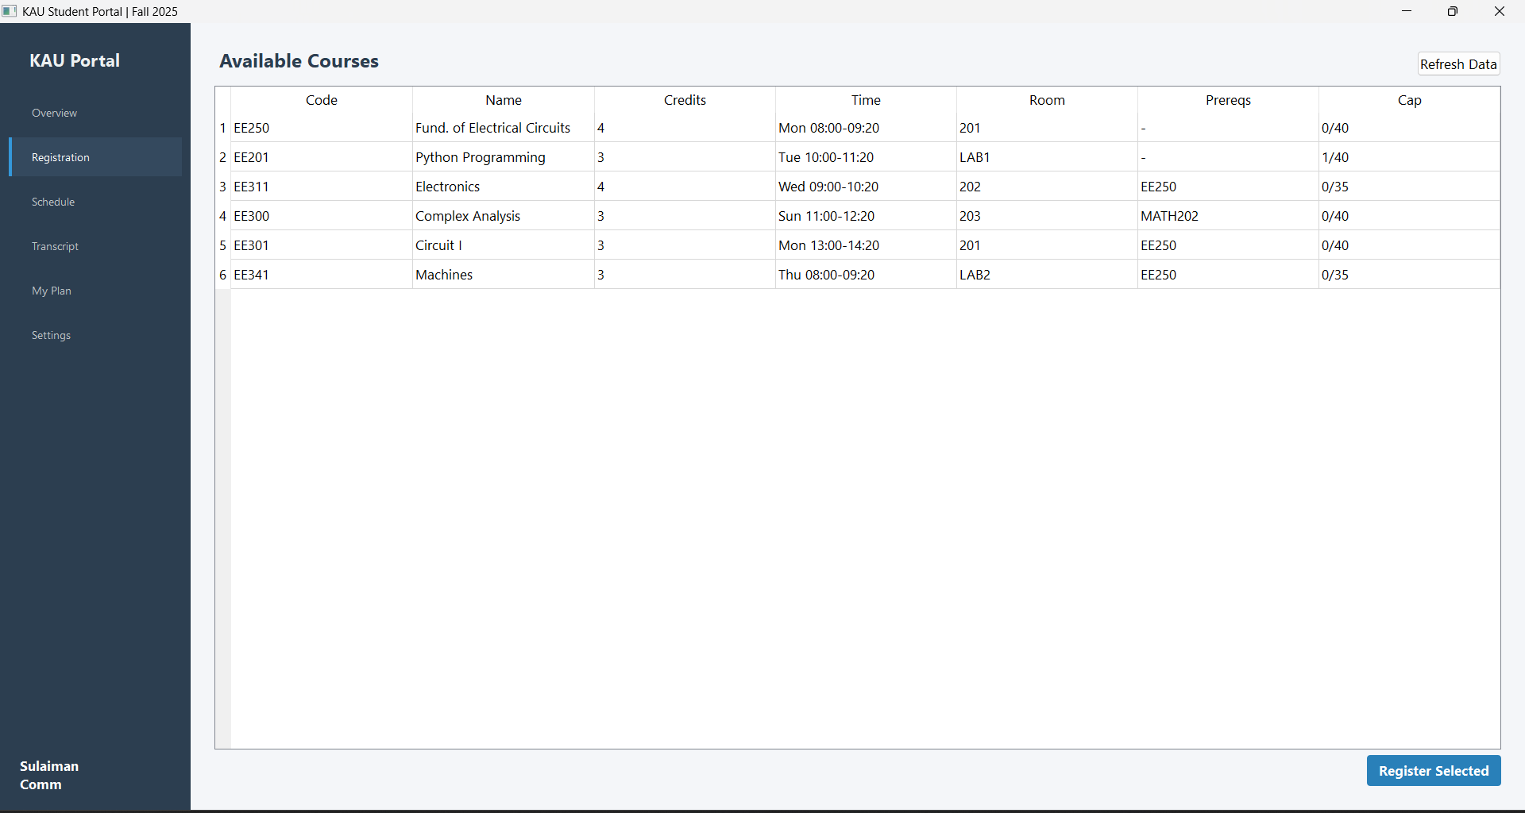
  (Student)
  Registration

Slide 14
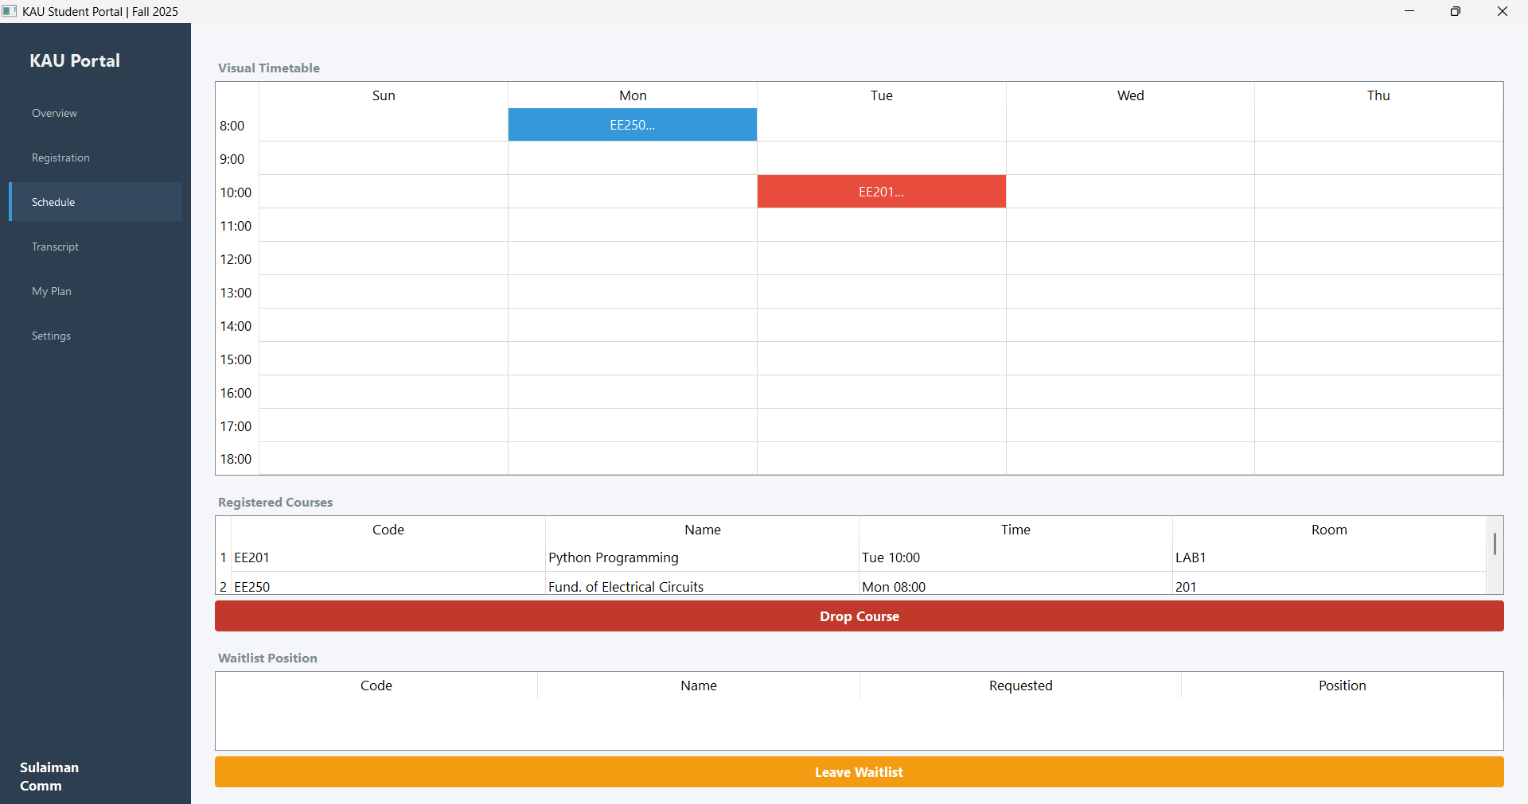
  (Student)
  Schedule

Slide 15
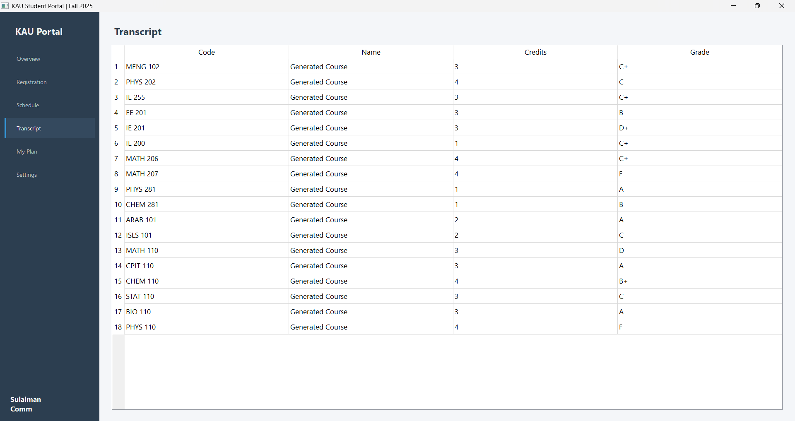
  (Student)
  Academic
  History

Slide 16
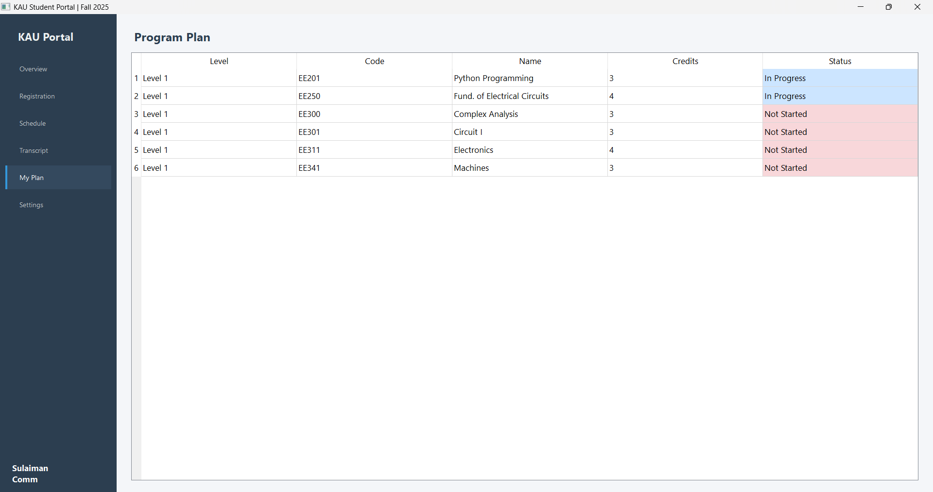
  (Student)
  My Plan

Slide 17
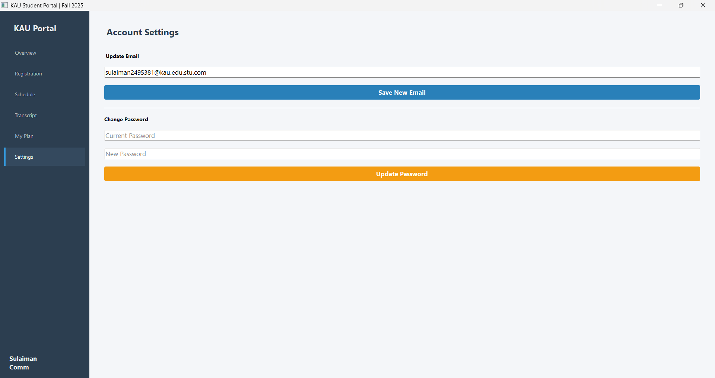
  (Student)
  Settings

Slide 18
  THANK YOU
  FOR LISTENING.

